Slide 1
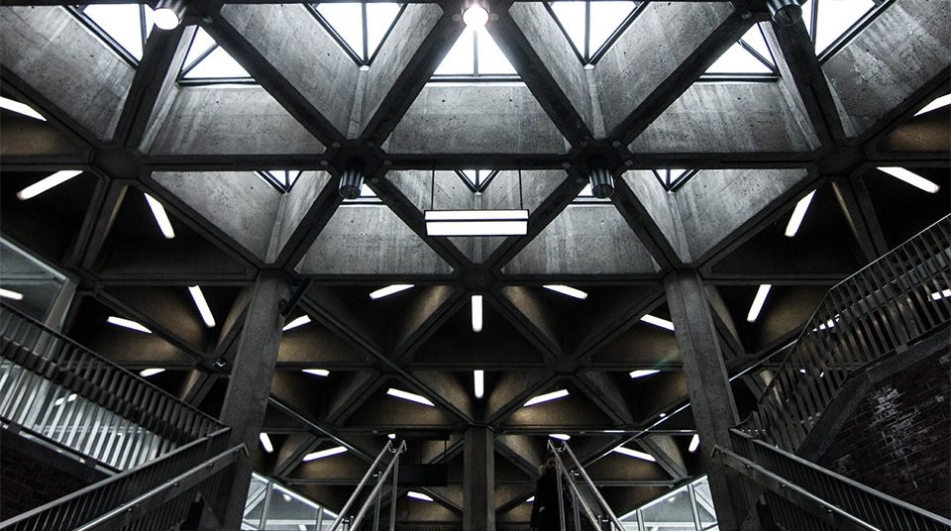
Clinical Notes for spinal cord

Slide 2
Lesions of the Anterior and Posterior Nerve Roots
A lesion of one posterior spinal nerve root will produce pain in the area of skin innervated by that root and in the muscles that receive their sensory nerve supply from that root.
Movements of the vertebral column in the region of the lesion will heighten the pain and coughing and sneezing will also make it worse by raising the pressure within the vertebral canal.
A lesion of an anterior root will result in paralysis of any muscle that is supplied exclusively by that root and partial paralysis of any muscle that is supplied partially by that root.

Slide 3
Tabes Dorsalis
Stabbing pains in the lower limbs
Paresthesia, with numbness in the lower limbs
Hypersensitivity of the skin to touch, heat, and cold
Loss of appreciation of posture or passive movements of the limbs, especially the legs
Ataxia of the lower limbs
Hypotonia
Loss of tendon reflexes

Slide 4
Spinal Cord Injuries
The injury is catastrophic since little, or no regeneration of the severed nerve tracts takes place and the individual is permanently disabled.
Treatment has been restricted to anatomical realignment and stabilization of the vertebral column or decompression of the spinal cord.
During the recovery process, the patient goes through intensive rehabilitation to optimize the remaining neurologic function.

Slide 5
Chronic Compression of the Spinal Cord
Extradural And Intradural CAUSES
The clinical signs and symptoms are produced by an interference with the normal anatomical and physiologic functions of the spinal cord.
Pressure on the spinal arteries causes ischemia of the spinal cord with degeneration of nerve cells and their fibres.
Pressure on the spinal veins causes oedema of the spinal cord with interference in the function of the neurons.
Finally, direct pressure on the white and grey matter of the spinal cord and the spinal nerve roots interferes with nerve conduction.
At the same time, the circulation of the cerebrospinal fluid is obstructed, and the composition of the fluid changes below the level of obstruction.

Slide 6
Spinal Shock Syndrome
Spinal shock syndrome is a clinical condition that follows acute severe damage to the spinal cord. All cord functions below the level of the lesion become depressed or lost, and sensory impairment and flaccid paralysis occur.
In most patients, the shock persists for less than 24 hours, whereas in others, it may persist for as long as 1 to 4 weeks. As the shock
diminishes, the neurons regain their excitability and the effects of the upper motor neuron loss on the segments of the cord below the lesion, for example, spasticity and exaggerated reflexes will make their appearance.

Slide 7
Complete Cord Transection Syndrome
Complete cord transection syndrome results in complete loss of all sensibility and voluntary movement below the level of the lesion.
It can be caused by fracture dislocation of the vertebral column, by a bullet or stab wound, or by an expanding tumour.
CLINICAL FEATURES:
Bilateral lower motor neuron paralysis and muscular atrophy in the segment of the lesion.
Bilateral spastic paralysis below the level of the lesion.
Bilateral loss of all sensations below the level of the lesion.
The Bladder and bowel functions are no longer under voluntary control since all the descending autonomic fibres have been destroyed.

Slide 8
Anterior Cord Syndrome
Anterior cord syndrome can be caused by cord contusion during vertebral fracture or dislocation, from injury to the anterior spinal artery or its feeder arteries with resultant ischemia of the cord, or by a herniated intervertebral disc.
CLINICAL FEATURES
Bilateral lower motor neuron paralysis in the segment of the lesion and muscular atrophy.
Bilateral spastic paralysis below the level of the lesion.
Bilateral loss of pain, temperature, and light touch sensations below the level of the lesion.
Tactile discrimination and vibratory and proprioceptive sensations are preserved because the posterior white columns on both sides are undamaged.

Slide 9
Central Cord Syndrome
Central cord syndrome is most often caused by hyperextension of the cervical region of the spine.
The cord is pressed on anteriorly by the vertebral bodies and posteriorly by the ligamentum flavum, causing damage to the central region of the spinal cord.
Clinical features:
Bilateral lower motor neuron paralysis in the segment of the lesion and muscular atrophy.
Bilateral spastic paralysis below the level of the lesion
Bilateral loss of pain, temperature, light touch, and pressure sensations below the level of the lesion

Slide 10
Brown-SE’quard Syndrome or Hemisection of the Cord
Hemisection of the spinal cord can be caused by fracture dislocation of the vertebral column, by a bullet or stab wound, or by an expanding tumour.
CLINICAL FEATURES
Ipsilateral lower motor neuron paralysis in the segment of the lesion and muscular atrophy.
Ipsilateral spastic paralysis below the level of the lesion.
Ipsilateral loss of tactile discrimination and of vibratory and proprioceptive sensations below the level of the lesion.
Contralateral loss of pain and temperature sensations below the level of the lesion.

Slide 11
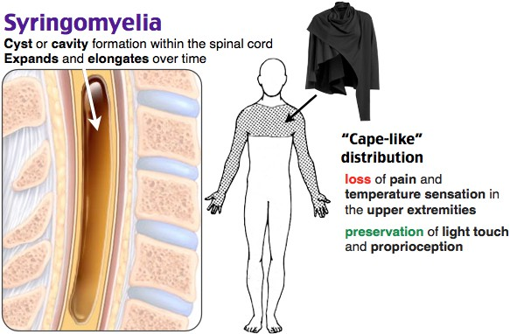
Syringomyelia
Syringomyelia, which is due to a developmental abnormality in the formation of the central canal, most often affects the brainstem and cervical region of the spinal cord.
Loss of pain and temperature sensations in dermatomes on both
sides of the body
Tactile discrimination, vibratory sense, and proprioceptive sense are
normal.
Lower motor neuron weakness is present in the small muscles of the
hand.
Bilateral spastic paralysis of both legs may occur

Slide 12
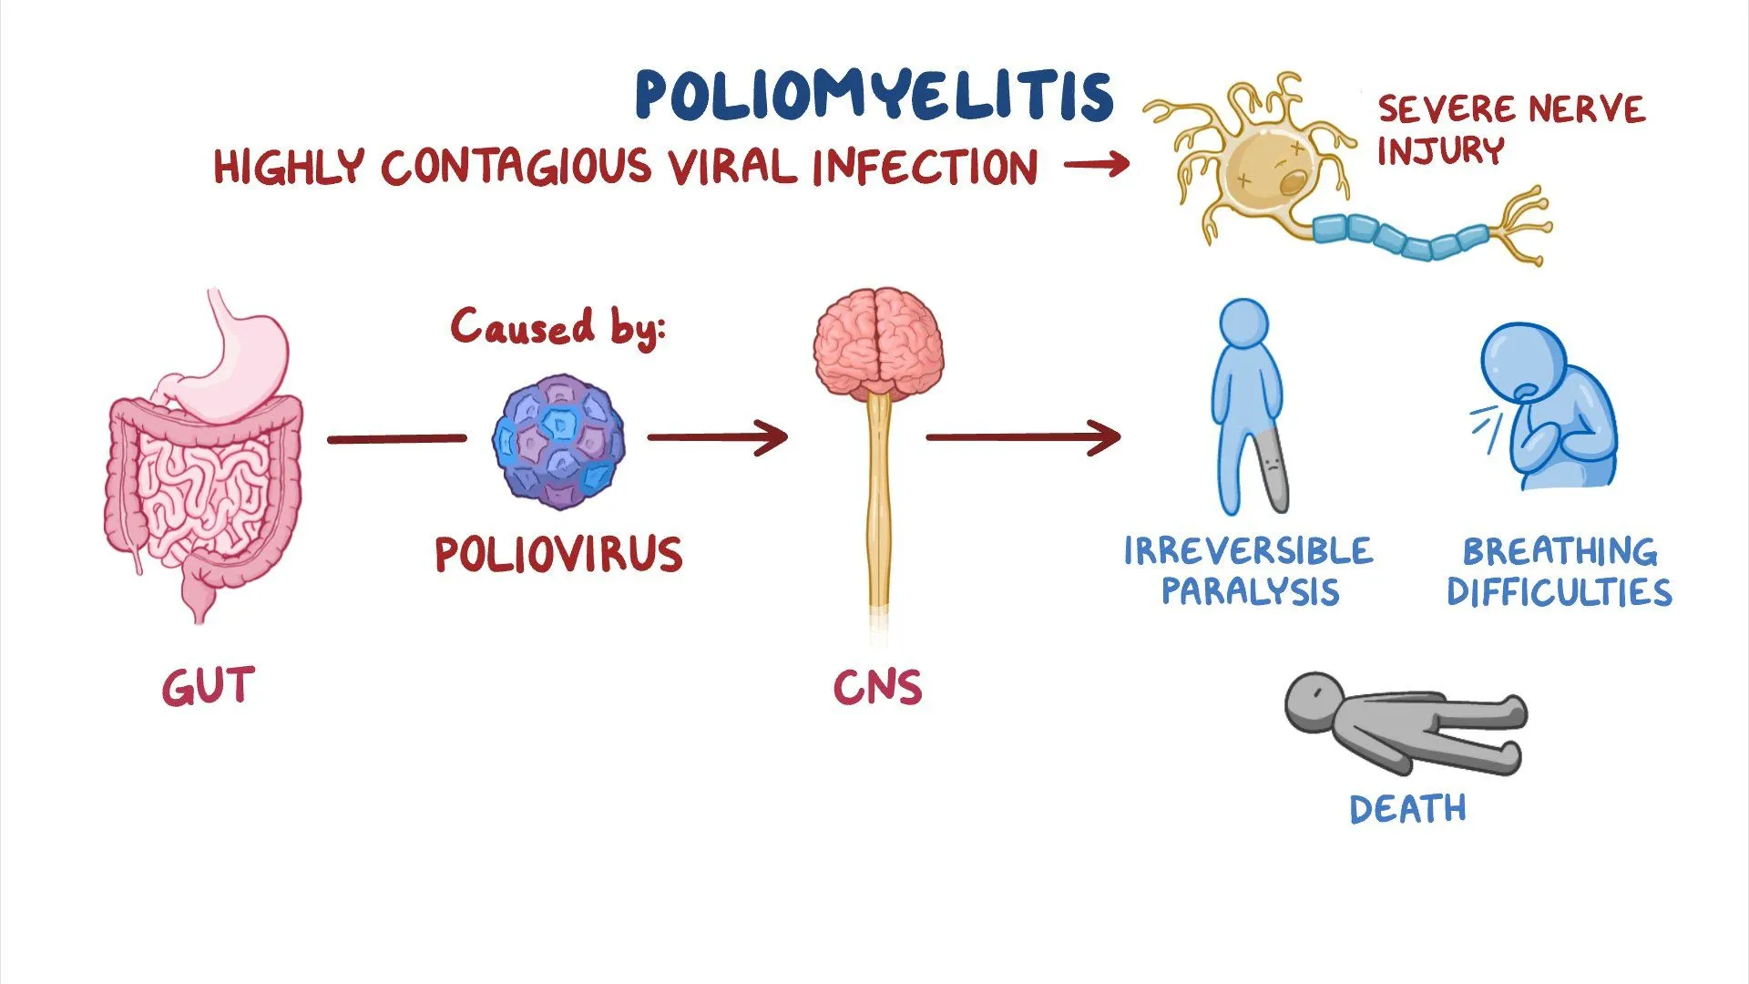
Poliomyelitis
Poliomyelitis is an acute viral infection of the neurons of the anterior grey columns of the spinal cord and the motor nuclei of the cranial nerves.
Immunization has greatly reduced the incidence of poliomyelitis, which was once a feared disease.
Following death of the motor nerve cells, there is paralysis and wasting of the muscles.
The muscles of the lower limb are more often affected than the muscles of the upper limb.
In severe poliomyelitis, respiration may be threatened due to the paralysis spreading to the intercostal muscles and diaphragm.

Slide 13
THANK YOU

